Slide 1
Regular Expressions

Slide 2
Problem
Write a Python code to check if the given mobile number is valid or not. The conditions to be satisfied for a mobile number are:
a) Number of characters must be 10
b) All characters must be digits and must not begin with a ‘0’

Slide 3
Validity of Mobile Number
Input | Processing | Output
A string representing a mobile number | Take character by character and check if it valid | Print valid or invalid

Slide 4
Test Case 1
abc8967891
Invalid
Alphabets are not allowed

Slide 5
Test Case 2
440446845
Invalid
Only 9 digits

Slide 6
Test Case 3
0440446845
Invalid
Should not begin with a zero

Slide 7
Test Case 4
8440446845
Valid
All conditions statisfied

Slide 8
Python code to check validity of mobile number (Long Code)
import sys
number = input()
if len(number)!=10:
print ('invalid')
sys.exit(0)
if number[0]==‘0’:
print ('invalid')
sys.exit(0)
for chr in number:
if chr.isalpha():
print ('invalid')
break
else:
print('Valid‘)

Slide 9
Manipulating text or data is a big thing
If I were running an e-mail archiving company, and you, as one of my customers, requested all of the e-mail that you sent and received last February, for example, it would be nice if I could set a computer program to collate and forward that information to you, rather than having a human being read through your e-mail and process your request manually.

Slide 10
Another example request might be to look for a subject line like “ILOVEYOU,” indicating a virus-infected message, and remove those e-mail messages from your personal archive.
So this demands the question of how we can program machines with the ability to look for patterns in text.
Regular expressions provide such an infrastructure for advanced text pattern matching, extraction, and/or search-and-replace functionality.
Python supports regexes through the standard library re module

Slide 11
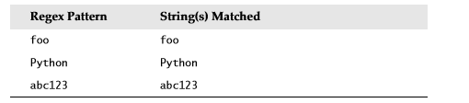
regexes are strings containing text and special characters that describe a pattern with which to recognize multiple strings.
Regexs without special characters
These are simple expressions that match a single string
Power of regular expressions comes in when special characters are used to define character sets, subgroup matching, and pattern repetition

Slide 12
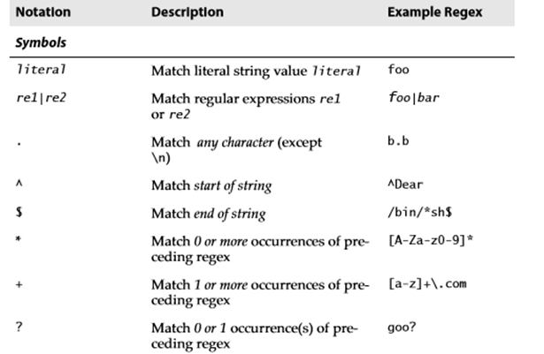
Special Symbols and Characters

Slide 13
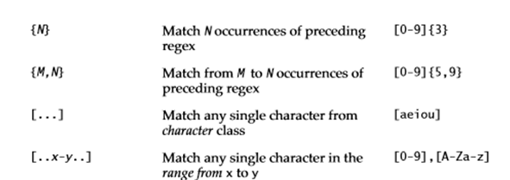
Special Symbols and Characters

Slide 14

Special Symbols and Characters

Slide 15
Matching Any Single Character (.)
dot or period (.) symbol (letter, number, whitespace (not including “\n”), printable, non-printable, or a symbol) matches any single character except for \n
To specify a dot character explicitly, you must escape its functionality with a backslash, as in “\.”

Slide 16
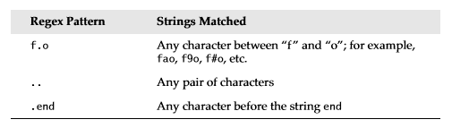

Slide 17
import re
if re.match("f.o","fooo"):
print("Matched")
else:
print("Not matched")
Output:
Prints matched
Since it searches only for the pattern ‘f.o’ in the string

Slide 18
import re
if re.match("f.o$","fooo"):
print("Matched")
else:
print("Not matched")
Check that the entire string starts with ‘f’, ends with ‘o’ and contain one letter in between
Notes:
Not matched

Slide 19
import re
if re.match("..","fooo"):
print("Matched")
else:
print("Not matched")
Matched
Two dots matches any pair of characters.
Notes:
import re
if re.match("f..q","fweq"):
print("Matched")
else:
print("Not matched")

Slide 20
import re
if re.match("..$","foo"):
print("Matched")
else:
print("Not matched")
Not matched
Including a ‘$’ at the end will match only strings of length 2

Slide 21
import re
if re.match(".end","bend"):
print("Matched")
else:
print("Not matched")
Matched
The expression used in the example, matches any character for ‘.’

Slide 22
import re
if re.match(".end","bends"):
print("Matched")
else:
print("Not matched")
Prints Matched

Slide 23
import re
if re.match(".end$","bends"):
print("Matched")
else:
print("Not matched“)
Prints Not matched - $ check for end of string

Slide 24
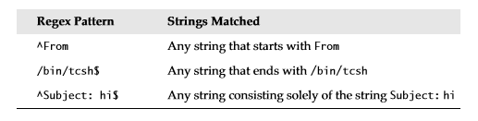
Matching from the Beginning or End of Strings or Word Boundaries (^, $)
^ - Match beginning of string
$ - Match End of string

Slide 25
if you wanted to match any string that ended with a dollar sign, one possible regex solution would be the pattern .*$
Notes:
import re
if re.match(".*$","hello bob$"):
print("Matched")
else:
print("Not matched")

Slide 26
Register number validity
Check whether the given register number of a VIT student is valid or not.
Example register number – 15bec1032
Register number is valid if it has two digits
Followed by three letters
Followed by four digits

Slide 27
Denoting Ranges (-) and Negation (^)
brackets also support ranges of characters
A hyphen between a pair of symbols enclosed in brackets is used to indicate a range of characters;
For example A–Z, a–z, or 0–9 for uppercase letters, lowercase letters, and numeric digits, respectively

Slide 28
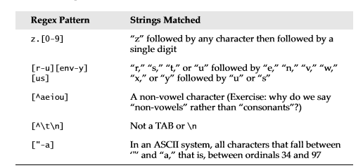
Notes:
import re
if re.match("[r-u][env-y]","qe"):
print("Matched")
else:
print("Not matched")

Slide 29
Multiple Occurrence/Repetition Using Closure Operators (*, +, ?, {})
special symbols *, +, and ?, all of which can be used to match single, multiple, or no occurrences of string patterns
Asterisk or star operator (*) - match zero or more occurrences of the regex immediately to its left
Plus operator (+) - Match one or more occurrences of a regex
Notes:
import re
if re.match(".*s","ends"):
print("Matched")
else:
print("Not matched")
import re
if re.match(".+s","ends"):
print("Matched")
else:
print("Not matched")

Slide 30
Question mark operator (?) - match exactly 0 or 1 occurrences of a regex.
There are also brace operators ({}) with either a single value or a comma-separated pair of values. These indicate a match of exactly N occurrences (for {N}) or a range of occurrences; for example, {M, N} will match from M to N occurrences

Slide 31
Code to check the validity of register number
import re
register= input()
if re.match("^[1-9][0-9][a-zA-Z][a-zA-Z][a-zA-Z][0-9][0-9][0-9][0-9]$",register):
print("Matched")
else:
print("Not matched")

Slide 32
^ - denote begin (Meaning is different when we put this symbol inside the square bracket)
$ - denote end

Slide 33
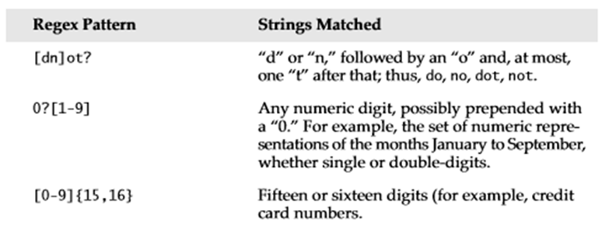

Slide 34
Refined Code to check the validity of register number
{n} – indicate that the pattern before the braces should occur n times
import re
register= input()

Slide 35
if re.match("^[1-9][0-9][a-zA-Z]{3}[0-9]{4}$",register):
print("Matched")
else:
print("Not matched")

Slide 36
Check validity of Mobile Number (Shorter Code)
import re
number = input()
if re.match(‘[^0][0-9]{9}',number):
print('valid')
else:
print('invalid')
Bug: Will also accept a843338320

Slide 37
Check validity of Mobile Number (Shorter Code)
import re
number = input()
if re.match(‘[1-9][0-9]{9}',number):
print('valid')
else:
print('invalid')

Slide 38
Check validity of PAN card number with RE
import re
pan=input()
if len(pan) < 10 or len(pan) > 10 :
print ("PAN Number should be 10 characters")
exit
Notes:
import re
pan=input()
if len(pan) < 10 or len(pan) > 10 :
print ("PAN Number should be 10 characters")
exit
elif re.search("[^a-zA-Z0-9]",pan):
print ("No symbols allowed, only alphanumerics")
exit
elif re.search("[0-9]",pan[0:5]):
print ("Invalid - 1")
exit
elif re.search("[A-Za-z]",pan[5:9]):
print ("Invalid - 2")
exit
elif re.search("[0-9]",pan[-1]):
print ("Invalid - 3")
exit
else:
print ("Your card "+ pan + " is valid")

Slide 39
elif re.search("[^a-zA-Z0-9]",pan):
print ("No symbols allowed, only alphanumerics")
exit
elif re.search("[0-9]",pan[0:5]):
print ("Invalid - 1")
exit

Slide 40
elif re.search("[A-Za-z]",pan[5:9]):
print ("Invalid - 2")
exit
elif re.search("[0-9]",pan[-1]):
print ("Invalid - 3")
exit
else:
print ("Your card "+ pan + " is valid“)

Slide 41
Python read all input as string
In some cases it is necessary to check if the value entered is an integer
We can check it using regular expressions
Rules for an integer
optionally begin with a negative sign include ^ symbol
first digit must be a number other than zero
may be followed zero to any number of digits
string must end with it so add $ symbol

Slide 42
import re
register= input()
#optionally begin with a negative sign include ^ symbol
#first digit must be a number other than zero
# may be followed zero to any number of digits
# string must end with it so add $ symbol

Slide 43
if re.match("^\-?[1-9][0-9]*$",register):
#'\' is added in front of '-' to overcome its default meaning in REs
print("Matched")
else:
print("Not matched")
Notes:
-90
9
Matched
0
Not matched

Slide 44
Rules for an integer or a floating point value
optionally begin with a negative sign include ^ symbol
first digit must be a number other than zero
may be followed zero to any number of digits
string must end with it so add $ symbol
Optionally followed by a ‘.’
Followed by zero or more digits
String ends here

Slide 45
import re
register= input()
if re.match("^\-?[1-9][0-9]*\.?[0-9]*$",register):
# ’.’ can occur zero or one time followed by a digit occurred zero to infinite number of times
print("Matched")
else:
print("Not matched")
Notes:
-90
Matched
90
Matched
0
Not matched
-90.999
Matched

